Slide 1
What Works for Children’s Social Care

Slide 2

Agenda
Who are we and what we do
How we are engaging with the sector
Current research projects
Focus on data

Slide 3
Who are we?
We want to ensure the best possible outcomes for children and families
We’re passionate about the difference good evidence can make
We want other people in children’s social care to be just as passionate
Notes:
We are an independent organisation, funded by the Department for Education.
Our mission is to create an evidence base for what works in children’s social care.
We’re passionate about evidence, and the difference it can make in people’s lives - We are dedicated to collating, creating and translating the best and most useful evidence possible to help social workers to support children and families.
But evidence is no good if no-one is using it, so we’re committed to usefulness, practicality and timeliness

Slide 4
So, what are we doing?
Pulling together what we already know
Improving the accessibility and relevance of the evidence
Supporting the good work that is already happening
Commissioning new research
Giving practitioners, young people and families a platform to share their experience
Notes:
Pulling together what we already know - together with our research partners at CASCADE at Cardiff University, we are doing reviewing the evidence that already exists on a range of interventions in children’s social care and making it accessible in our Evidence Store. We’re collating it in a way that makes it useful to practitioners - we’ve rated the effectiveness of the intervention and the strength of the evidence, so you can see how each intervention stacks up at a glance, we’ve summarised it in plain English to make it easily digestible for busy professionals, and where possible we’ve included case studies and additional resources to help you on your way if you think an intervention might be of use.
Supporting the good work that in already happening - we are doing this in a number of ways - through evaluations and roll-outs of projects that have come through the DfE’s Innovation programme, such as FGC, FDAC, Mockingbird, Leeds Family Valued, North Yorkshire’s No Wrong Door, Herfordshire’s Family Safeguarding Model. We’re also doing it on a slightly smaller scale though our Practice in Need of Evidence (PINE) programme - helping local authorities and other organisations to evaluate their own promising practices.
Commissioning new research - change projects putting social workers in schools in Lambeth, Southampton and Stockport, and giving devolved budgets to social workers in Darlington, Hillingdon and Wigan, providing social work supervision to Designated Safeguarding Leads (DSLs) in Bolton (a project spearheaded by the PSW there), understanding predictive decision-making by social workers, and low-cost interventions to improve social worker well-being and reduce sickness and turn-over - Happier Healthier Professionals
Platform to share experiences - Stakeholder, Advisory Group, Young Person Advisors, regular visits to local authorities to talk with practitioners

Slide 5

The principles of ‘What Works’
Impact
Nuance
Usefulness
Empowerment
Notes:
Add descriptions

Slide 6
Working with Stakeholders

Slide 7

The sector has always been an important part of our journey
Local authorities
Independent social workers
Charities
Children, young people and families
Experts by experience
Sector bodies
Notes:
During the set-up phase we received advice and guidance from a number or panels and groups comprised of people working in the sector or with experience of children’s social care.
We are continuing to see this advice and guidance as we move forward
We want to work with every local authority in some way, but we’re delighted to be working with two thirds of them already

Slide 8
Stakeholder Advisory Group
Representatives from
Social work practitioners
Experts by experience
Social work practice leaders
Social care charity sector
Social work academia
Notes:
Meets three times a year
They advise on research design, on strategy and approach, and research priorities
Recruited with help from SCIE following an open application process

Slide 9
Engagement with Children and Young People
Young Advisors
Young people who meet regularly with the WWCSC senior management team
Provide input on current and prospective research projects
Ensure the voice of young people with experience of social care heard
Broader engagement
Currently exploring how to engage a wider range of children and young people with experience of social care
Investigating online and app-based options
Notes:
At the moment our key way of engaging with young people is through our Young Advisors panel.
We meet with them regularly to discuss current and future research projects. Their unique perspective has helped shape our research EXAMPLE NEEDED
We are also looking at other ways to engage with children and young people, such as via the mobile app Mind of My Own

Slide 10
Social Worker Polling
Asking the social workers what matters to them
Helping to shape our research priorities
We aim to sign up 1,000 social workers across the country and conduct online polls once month.
Notes:
Understanding attitudes and behaviour toward research and other key issues
Polls sent via email roughly every month
Quick, easy response
Incentive to join
Taking the pulse of the industry/

Slide 11
Trials, Pilots and Research

Slide 12
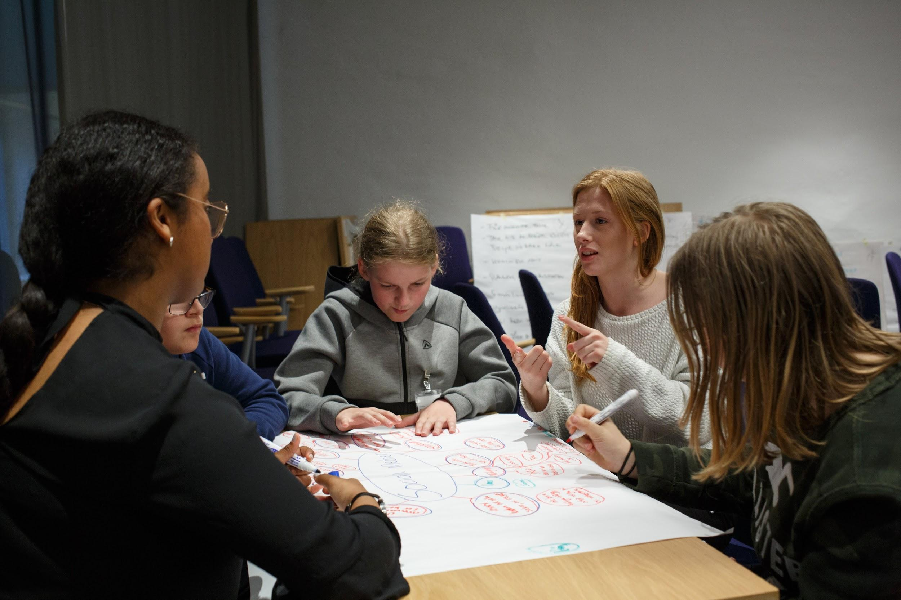
EVALUATION

Slide 13
Strengthening Families, Protecting Children
Evaluating the roll out of three whole system change interventions:
Leeds Family Valued
Hertfordshire Family Safeguarding
North Yorkshire’s No Wrong Door
Each model will launch in a non-randomly selected trailblazer, followed by a pilot evaluation. The interventions will then be rolled out in a random order to a further five local authorities for each programme (15 in total).
We will be evaluating outcomes in children’s social care and education
Notes:
Family Safeguarding: Developed in Hertfordshire, Family Safeguarding is a model of system change where specialist adult practitioners are embedded within Family Safeguarding teams of social workers. Teams are trained in Motivational Interviewing, undertake group case discussion, follow a structured solution-focussed intervention programme with families and record and share information using an electronic assessment workbook.
Leeds Family Value: An approach that puts the family at the centre of a multi-agency restorative approach, that puts supports in place to find sustainable solutions and empower the family to find the strength to change. There are three steps - 1) Training practitioners in restorative practice; 2) Expanding Family Group Conference; 3) Commissioning more service for families who have experienced domestic violence or have had a child taken into care
North Yorkshire No Wrong Door: a new way of providing support to young people who are within or on the edge of the care system. It replaces traditional council-run young peoples' homes with hubs which combine residential care with fostering. Each hub has a dedicated team which includes: a life coach who is a clinical psychologist; a speech therapist; two community foster families who work out of the hub and are part of the professional team; and community supported lodging places for 16 and 17-year-olds, again staffed by people who are specially trained and are part of the professional team.

Slide 14
Supporting Families, Investing in Practice
This programme expands the roll-out and use of three promising interventions in over 60 local authorities:
Family Group Conferencing
Family Drug and Alcohol Courts
Mockingbird Family Model
The programme will be designed and run by independent evaluators, Coram, NatCen and the Rees Centre, Oxford University
The programme is run in partnership with the Department for Education, Daybreak, the Centre for Justice Innovation and The Fostering Network.
Notes:
Family Group Conferencing - a mediated formal meeting between extended family members and other officials such as social worker, medical professionals, or the police, where everyone comes together to make decisions regarding the safeguarding and wellbeing of a child. The process has four main stages, which includes a meeting where professionals inform the family of the concerns they have, followed by private family time, where the family alone develop a plan that addresses the concerns that have been raised. The plan is then presented to the professionals who should support it if the concerns have been addressed and it does not put the child at risk. The meetings are facilitated and co-ordinated by people independent of casework decisions in the agency working with the family.
Family Drug and Alcohol Courts

Slide 15
Signs of Safety
Working to improve evidence base for Signs of Safety
Main evaluation is a mix of qualitative evaluation and analysis of national level outcome data
Supplemented with a quasi-experimental difference in difference approach, comparing outcomes in the ten pilot authorities with those in other authorities matched on characteristics and trends
Notes:
Following our Systematic Review of Signs of Safety, which found no good quality evidence of the impact of Signs of Safety, we are evaluating the Innovation Programme wave two Signs of Safety project
Main evaluation, conducted by the Social Care Workforce Research Unit at King’s College London, is a mix of qualitative evaluation and analysis of national level outcome data
To provide a richer understanding of the impact of Signs of Safety this analysis will be supplemented with a quasi-experimental difference in difference approach, comparing outcomes in the ten pilot authorities with those in other authorities matched on characteristics and trends

Slide 16
Practice in Need of Evidence (PINE)
Who is it for?
Local authorities and organisations using the most promising practices, who want to develop evidence of what works
How does it work?
Local Authorities and organisations are provided with tools and support, via our PINE Portal, to help them evaluate their practices and produce robust evidence
Outcomes
Preliminary evidence of the effectiveness of a promising practice
An organisational culture that values and uses evidence
Strong partnership between WWCSC and the sector
Notes:
Working with the most promising practices and the most rigorous methods to find out what works
Using a suite of products and services that support local authorities on their journey to robust evidence
Changes organisational culture by building demand for and capability to use evidence
Facilitates strong partnership, working with the sector (doing with, not to)
Deepens our understanding of current practice and the challenges faced by practitioners and practice-leaders
EXAMPLES NEEDED!!

Slide 17

Bolton Metropolitan Borough Council
Designated Safeguarding Leads in school are responsible for safeguarding but have no formal supervision.
Hypothesis that this impacts on the quantity and quality of referrals to children’s social care.
The project aims to support Designated Safeguarding Leads in Bolton to manage the demands placed on them through formal supervision.
Notes:
Randomised Controlled Trial
Project suggested by the Principal Social Worker in Bolton
Monthly supervision sessions with Designated Safeguarding Leads from half of all primary schools in Bolton

Slide 18

CHANGE
PROJECTS

Slide 19
Change Projects
Focusing on key issues that the Centre identified through its initial engagement and research work with the sector and key stakeholders
Running until March 2020
Two projects
1. Locating social workers in schools to work with children and families
2. Empowering social workers to take budgetary decisions to prevent the need for children to enter care

Slide 20
Social Workers in Schools
Does bringing social work expertise and decision-making closer to where children are located help reduce the need to refer children to statutory processes?
Social workers placed in schools in three local authorities:
Lambeth
Stockport
Southampton
Findings expected Spring 2020
Interim findings oublished - August 2019
Notes:
The project was implemented differently in the various local authorities - embedding one social worker in a school, or having a group of social workers look after a cluster of schools, focusing on statutory work, or engaging in more early intervention or pastoral work etc.
Showing early signs of improving inter-agency working and building more collaborative relationships with children, young people and families. However, there have been some issues regarding mobile working, IT access, data sharing, caseloads and cultural differences between school and social work cultures

Slide 21
Devolved Budgets
Does giving social workers discretionary budgets and the authority to use them in way they see fit help safely reduce the number of children entering care?
Discretionary budgets devolved to children’s social work teams in three local authorities:
Darlington
Hillingdon
Wigan
Findings expected Spring 2020
Interim findings published - August 2019
Notes:
Like SWIS before, the devolved budgets have been implemented in slightly different ways in each LA - levels of red tape or ‘permission’ needed, amount available to spend, target audience
Budgets used for various purposes - to engage children and families with social services, to reward good behaviour, to provide assessments and treatment for children and parents that would not otherwise be available or that has a long waiting list (educational psychologist, psychological therapy etc), making improvements to living conditions, providing practical skills to parents (driving lessons, cooking class) to enable them to undertake particular tasks and improve confidence
Though the interventions were still “bedding in”, the pilots are showing early signs of promise, and have benefited from broad acceptance from the children’s social care professionals involved. Social workers reported that the devolved budgets allowed them to help families in ways that would otherwise not have been possible, and help them engage families and build stronger relationships

Slide 22

WORKPLACE
WELLBEING

Slide 23
Healthier, Happier Professionals
Working to understand how to support and increase the health, happiness and productivity of social workers in England
Drawing on learning from behavioural science to improve:
job satisfaction and engagement
productivity
work/life balance,
work-related stress,
turnover and other factors that impact on workforce wellbeing
In partnership with the Harvard Business School and University College London
Notes:
We have a number of projects in this area
Symbolic awards - SWs receive a personalised letter from their manager thanking them for their hard work
Goal setting - encouraging SWs to spend time making and reviewing weekly goals
Coffee - high quality tea and coffee as thank you for their hard work

Slide 24
Schwartz Rounds
Schwartz Rounds offer a way of bringing people together, to share stories about their work and about themselves, and to listen to others.
The are also open to the whole organisation, not just social workers.
Project will investigate if Schwartz Rounds can help social workers feel more supported in their jobs, allowing time and space to think and reflect.
Notes:
They are not used for making decisions, revising care plans or setting goals. Instead, they offer a different kind of discussion.
Schwartz Rounds have already been effective in healthcare settings. Evidence shows that healthcare staff who attend regularly feel less stressed andless isolated.
Early signs of promise have prompted us to start wave two of the project. Six local authorities started in wave one, with an additional five starting in autumn 2019
Schwartz Rounds are have begun in Haringey, Liverpool, Walsall, Nottinghamshire, Warwickshire and West Sussex and will shortly be extended to Bath and North East Somerset, Derby, Leicester, Enfield and Swindon

Slide 25
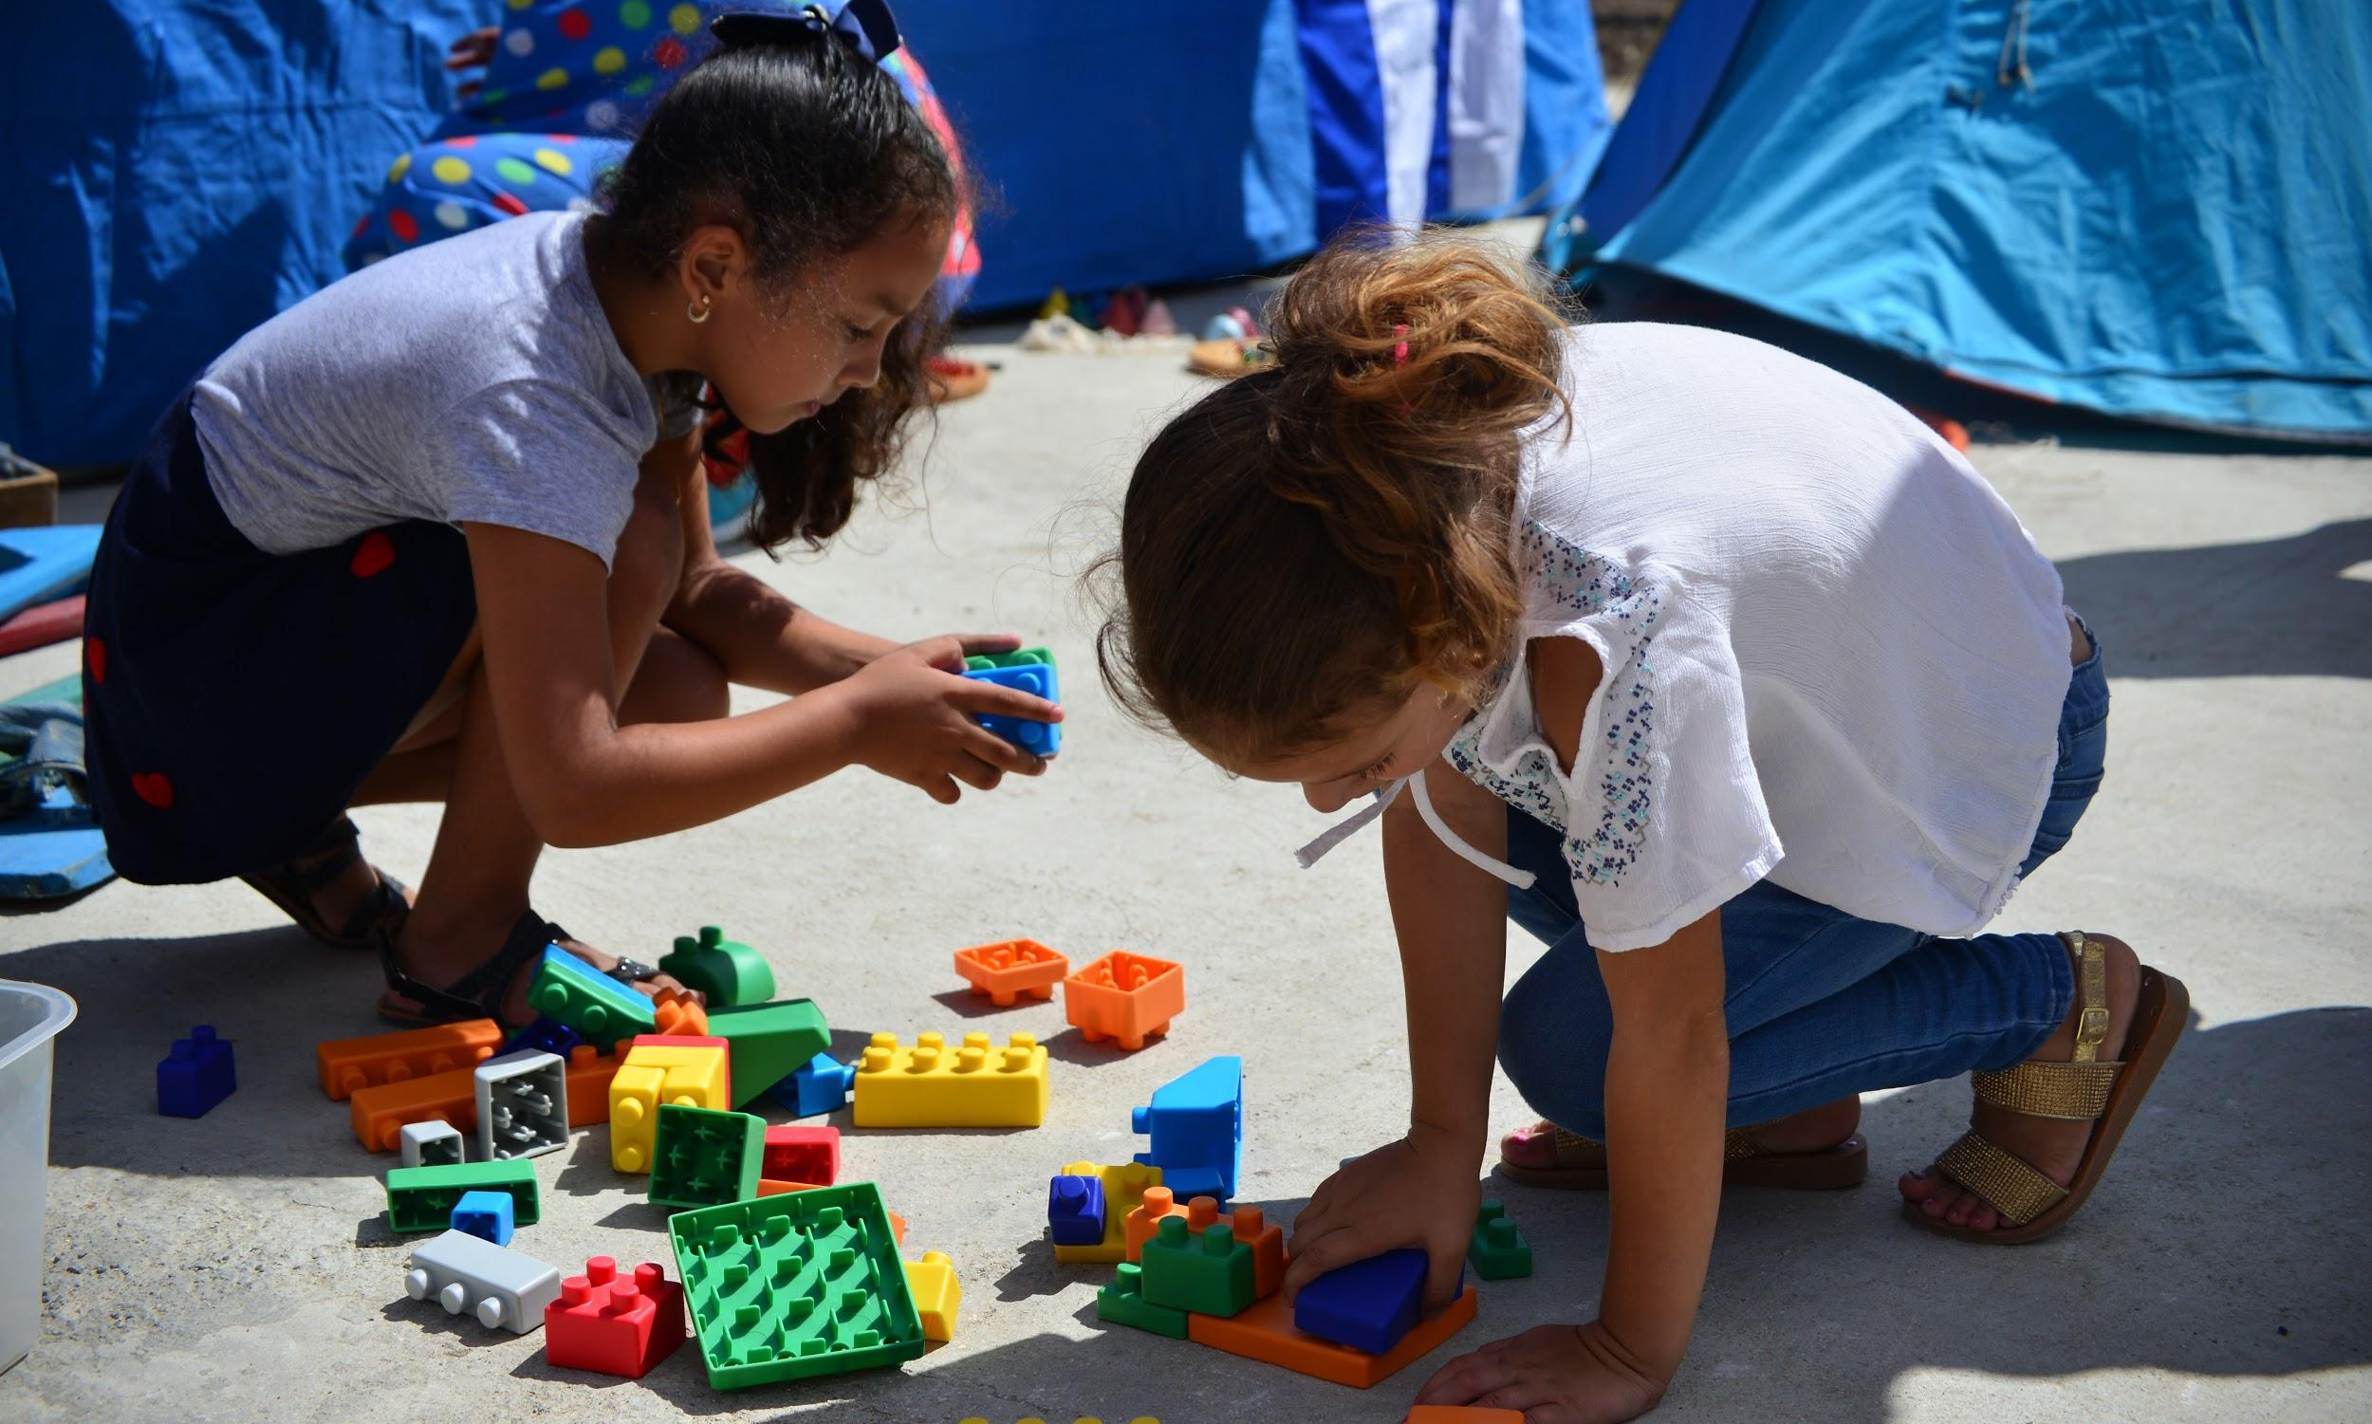
DATA
ANALYSIS

Slide 26

Re-analysing Trials from Other What Works Centres
Re-analysing around 85 trials to determine the effectiveness of the interventions for children at different stages of the children’s social care system
The work will take two forms:
re-analysis of individual trial data focussing on these children in particular
meta-analyses of numerous studies grouped together to understand the effectiveness of broader themes of interventions
Notes:
Potential to provide indications for improving outcomes without running entirely new studies

Slide 27
What Works in Predictive Analytics
A number of local authorities are already using predictive analytics.
Independent evidence is needed to show to what extent it works and is acceptable in children’s social care.
We are testing this out in 6 local authorities.
We have also commissioned an independent ethics review by the Rees Centre, Oxford University, and the Alan Turing Institute
Notes:
We believe it is vital to ensure there is a solid evidence base for when, where and for what kinds of tasks these models provide value to social workers
The project tests the accuracy of the model’s ability to predict outcomes from historical data, to understand the potential effectiveness and usefulness of predictive models
We are currently running the model against historical data in six local authorities

Slide 28
Data and Insight Communities
Who is it for? Service managers who want to take an empirical approach to service improvement, using their existing data
Aims
Service improvement
Bring LAs onto a platform which makes it quick, easy and safe to use data analysis tools.
Create peer networks with common language and tools for problem solving.
Encourage a culture of empiricism.
Notes:
Deliver a direct impact on the sector by accelerating service improvement
Bring LAs onto a platform which makes it quick, easy and safe to start using apps which can provide insights from their sensitive data
Bring service managers into peer networks with a common language and set of tools for describing and collectively solving key problems
Encourage a culture of empiricism in service managers, making it normal to demand higher quality evidence to describe problems and to be involved in creating it.

Slide 29
Themes from Data Projects
National data sets are limited in scope and usability
A lack of common definitions is a barriers to more advanced data analysis
Access to local data needs to be negotiated on a org by org basis (DPIA)

Slide 30
Over to you

Slide 31
@ABacchoo
Thank you

