Slide 1

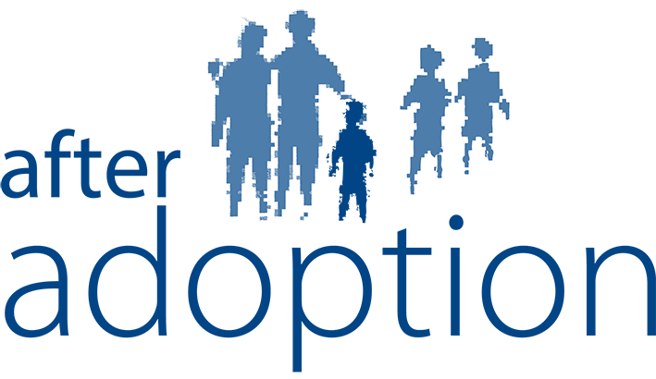

Slide 2


Effective Understanding of Life Journeys
Key Messages from Adopted Young People

Slide 3
YP NAS Consultation: Life Journey Work
TalkAdoption were approached by the National Adoption Service in Wales to consult with adopted young people around their thoughts and feelings about Life Journey Work. This is what they had to say…
Notes:
When we were invited along today we were asked to contribute the key messages from adopted young people around effective ways for them to have a thorough understanding of the life journey. As already highlighted, we have, and continuously host opportunities to give their views- and, with our remit in mind, we wished to shared with you a film that was created by our TalkAdoption Service in Wales as part of the National Adoption Service Consultation with Young People, hosted in February 2017. In this Adopted Young People from TalkAdoption were asked to share their thoughts and feelings about life journey work.
Ruth Letten- TalkAdoption Youth Worker, Wales
Mandy Squires- Therapist and Social Worker- private practice under the name of The Therapy Project and is a founder member of the Creative Therapies Collective, an organisation in South Wales run by arts therapists.

Slide 4
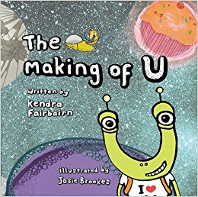

Key messages
Integral to the adoption journey- ‘It helps me to understand who I am’
Notes:
Children and young people have told us how important life story work is in allowing and enabling them to understand who they are and where they have come from. Life story work is integral to the adoption journey of children and young people in enabling them to understand all of the factors that make them who they are. Many young people have highlighted the importance of having an understanding of their own adoption journeys from as early an age as possible and having a safe space with people they trust to talk about this. Young people have recognised the importance of support for their parents in how best to tell their child about their history and appreciate that it may be difficult for their parents, it is essential for them.
Holly- I didn’t have a life story book, or ‘life story work’ as such but it doesn’t matter- as I created my own over the years. I knew I was adopted because I was old enough to understand and I remember meeting my adoptive parents and have memories of my foster family. My parents have helped me over the years to help me to understand who I am. They’ve been supportive and never turned me away from a conversation. They’ve always answered my questions when I’ve asked about my past.

Slide 5

Key messages
Life story work is life long
Notes:
Life story work should not just be a static/ ‘one off’ piece of work. Children and young people have told us that although they feel that life journey information should be shared as early as possible, these needs to be revisited and developed/ added to over time and as they get older they should be told more and more information that is reflective of their age and understanding. How life story work is communicated also needs to be appropriate to the individual child, and additional opportunities to provide context should be incorporated- e.g. contact, school lessons on family, etc.
Holly- My parents would give me more information, and make it easier to understand and as I got older they let me know a bit more about it in way a that suited my age- in an age appropriate way. Sometimes time would pass and I’d perhaps forgotten bits of information so I would ask again, and my parents used to explained it a different way to help me to understand.
When I got older I wanted to know more. When my parents couldn’t answer my questions they got support for me from After Adoption to help me know more about specific questions I wanted to know about. Later, when I turned 18 I accessed my adoption records with After Adoption- my mam and dad supported me with this- they were even in the room when I got my records, as they knew that seeing the records was going to affect me and they wanted to be there for me. It feels more normal now- I done it- Ive been told everything that social services knew, I’ve spoken to my birth mother (this wasn’t a great experience), I’ve come to terms with it because that’s all I ever wanted was to have my file and talk to the people who gave us away and seeing them for who they really are. It helped me to understand I have a better life.

Slide 6
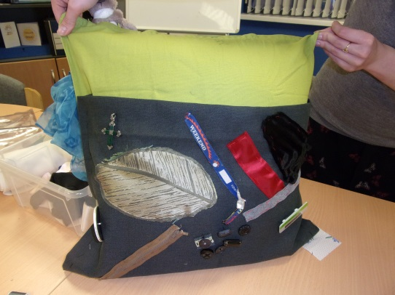
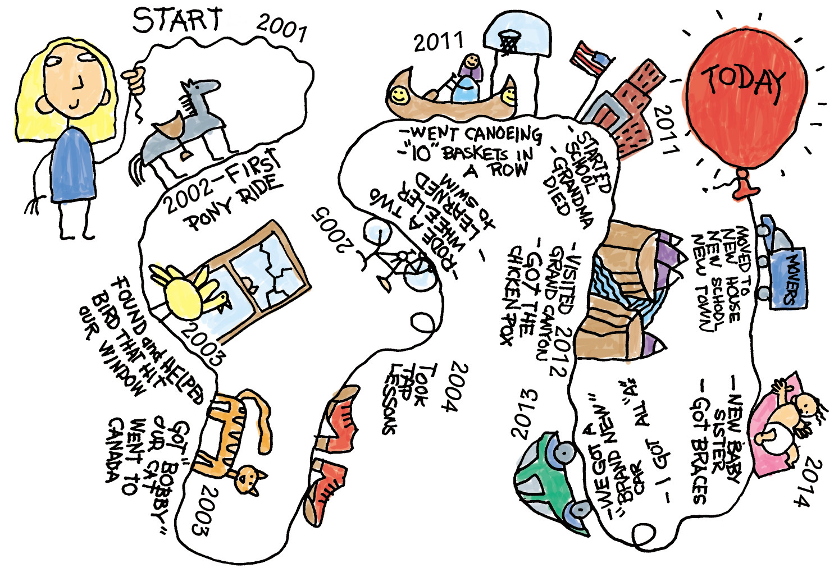

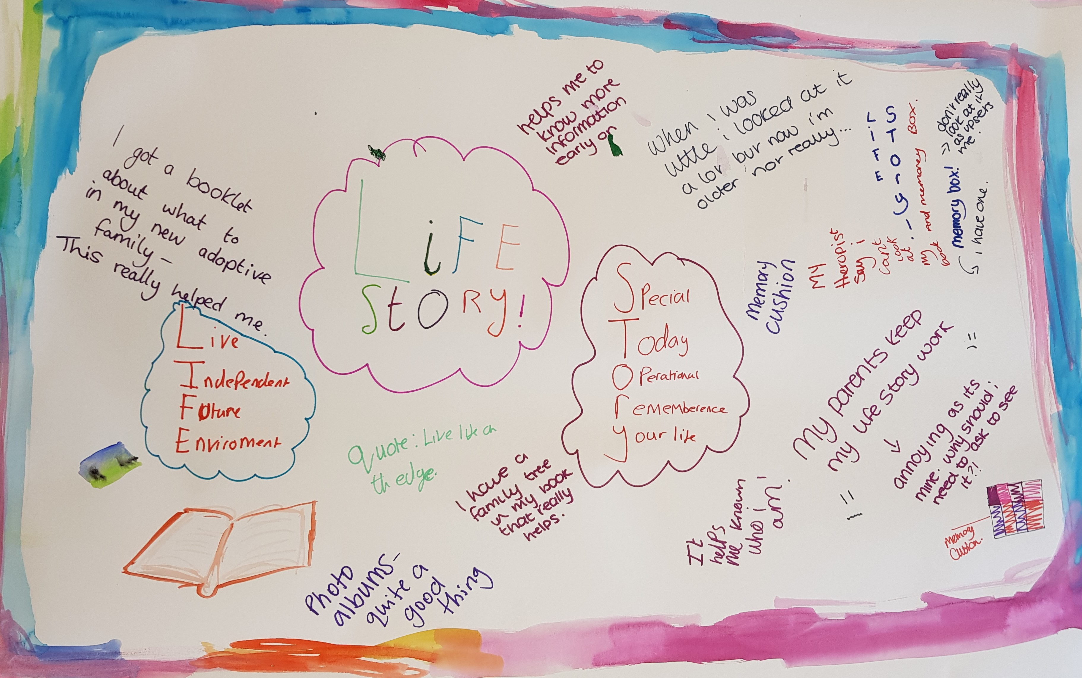
Key messages
Actively involve the child/ young person
Notes:
Life story work should be child centred and allow the child a sense of ownership, especially for older children. This can allow the child to develop a better understanding, focusing on the information that they want to know, and when they want to know. We know that children and young people can be experiential learners so being creative and actively involving the child can support them understand at their level and their pace, allow ownership to support understanding. At TalkAdoption we have seen young people reflect on their experiences using art, animation, making memory cushions, and various other creations and we see how this engages them effectively. Some young people prefer visual aids or props to encourage conversations and make sense of their world.
Holly- I created my own memory box without actually realising I was doing this- I started collected stuff from when I was about six and I put things that meant something to me in an important suitcase (this was a gift from my adoptive great grandfather when I very first became part of the family). I would put in there gifts from my older brother and others things I found really important to me- not just stuff from before my adoption, but things that were important afterwards. I also had a photo album with pictures of my birth family- this was on a bookshelf so I could look at it anytime I wanted to, and a photo album created by mam and dad ‘welcome to the family’ (in suitcase) as it tells me about their background and who they are. As part of the steering group I suggested making memory cushions to involve people in something creative that they could also keep to help them think about life story. This is something I had done as my own project for my mams 40th birthday as a present to her and I thought it would be good for adopted people to do too. It can help people to talk and think about their emotions and how to communicate their emotions when they don’t want to talk or when people just can’t talk. Another example is when I was younger I used to write letters to my parents to try to explain why I was upset and what I needed for them because it was hard to say it out loud.
Claire- Young people have also told us that is essential to allow the child to feel in control- if they don’t want to talk about it right now, that’s also ok- but leave the door open- ‘check in’. If they want to know information about specific details- explore what they want to know. If they information is not there or cannot be told- be open and honest about it.

Slide 7

Key messages
Relationships are fundamental
Notes:
Effective life story work can strengthen relationships between adopted children and their parents. In consultation with young people, some children became frustrated or upset when talking about feeling information is hidden from them. They did appreciate this is sometimes because it is not appropriate to know about because of their age but this seen ‘secrecy’ can be really difficult for children non the less and can impact on the relationship and trust that they have with their parents. In addition, many young people feel that they want to know more about their birth family, especially their birth siblings, as often they do not receive information or any updates about them.
Holly- We used to have four visits a year with my older brother (Barry) who remained in long term foster care. This was really hard for me, it was extremely difficult, over the years I felt like an outsider because he seemed closer to my younger brother and had more in common. My parents understood how hard it was and used to talk to me in the week leading up to contact and the week afterwards to make sure I felt ok. It helped that I new he was there (although sometimes I would worry about him)- this was important to me because he was part of my journey, even if he wasn’t there to see it.
I spent most of my life dreaming of meeting the people that would give me the answers that I needed. My birth father passed away so unfortunately I didn’t get to meet him or ask him any questions. This led me to seeking out my birth mother as it made me think that anything could happen and she could be gone as well. After a few months of meeting her it turned out she wasn’t what I had dreamt of or what I needed at that time, and she showed her true colours- which is difficult to process and understand. Looking back on it now even though it wasn’t what I wanted it’s made me realise that my life is a lot better and there’s reasons for me to go through what I had because she wasn’t able to provide what I needed. This has given me closure.
My parents helped us to trust them by never lying or hiding the true facts about adoption away from us- they’ve been like this with most stuff. They’ve always supported my ‘need to know’ and helped me when they did not know the answer. I have appreciated everything they have done for me and now, as I’ve matured, I understand that this has happened because they want the best for me.

