Slide 1
LGBT Adoption Project
Emma Owen – Head of Fundraising and Marketing
Jean Smith – Assistant Director of Adoption
Rachel Edge – Enquiries and Placements Officer
Notes:
Emma Introduce everyone

Slide 2
Introduction
PACT LGBT adopters project, funded by DfE expansion grant
Based in Brighton
LGBT parents open to priority children
Now working with 29 LGBT families
23 LGBT PACT families have children placed
All LGBT placements are for priority children.
Notes:
Emma
PACT project & grant. DfE grant of £400,000
Expansion grant LGBT specific service, based in Brighton
Research by Cambridge University into adoptive families headed by same-sex couples paints a positive picture of relationships and wellbeing in these new families. The study, which was carried out by Cambridge University, suggests that adoptive families with gay fathers might be faring particularly well.
Brighton chosen – high % of LGBT people in Brighton
29 families ( in assessment or placed ) – Of our current adopters are 23 are LGBT
All LGBT placements are for priority children. All are approved, matched, linked for priority children
Barnardos project & grant

Slide 3
Why LGBT make good adopters
Already known they will create their family by a different method
Made this choice a long time ago.
Known will not have a birth baby
Makes them well prepared for adoption
Interested in parenting and family
By the time they reach us, they already have good knowledge of adoption
Acceptance of priority children including siblings
Notes:
Jean
Already known they will create their family by a different method
Made this choice a long time ago.
Known will not have a birth baby- not the case with same-sex female couple, majority of same sex female couples come to us after
Makes them well prepared for adoption
Interested in parenting and family
By the time they reach us, they already have good knowledge of adoption
Acceptance of priority children including siblings

Slide 4
NFS research , facts and figures
20,000 dependent children living in same sex families
1375 adoptions by LGBT people in UK
Notes:
Jean
in 2013 there were around 20,000 dependent children living in same-sex couple families
As of 2 October 2015, there had been 1,375 adoptions by LGBT people in Great Britain since reporting began

Slide 5
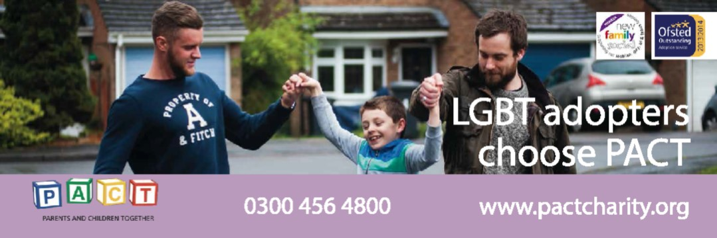
Recruitment
Focus groups
Targeted advertising/social media
Adopter Champions
Notes:
Emma
Focus groups – specifically LGBT, find out what worked, especially marketing
Images they highlighted
Original targeted advertising, social media
Adopter Champions
Lesson: tried more general, not specific LGBT, had impact on enquiries. Therefore reverted back to targeted for LGBT

Slide 6
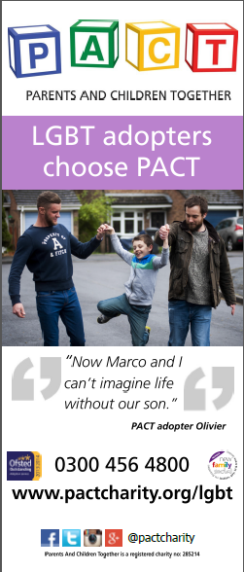
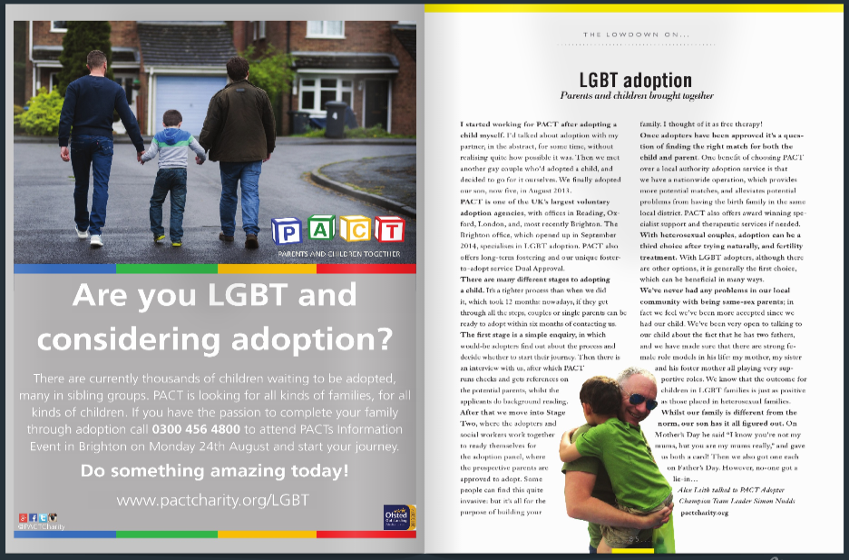
Targeted advertising
Notes:
Emma

Slide 7
Why LGBT choose PACT
Specialised service/office – targeted at LGBT
LGBT speakers
Network of other LGBT organisations
Drop-ins
Expanding drop-ins to other offices
Staff open
Staff training (NFS)
No drop off in non LGBT adopters
All PACT LGBT adopters get membership of NFS
Notes:
Jean

Slide 8
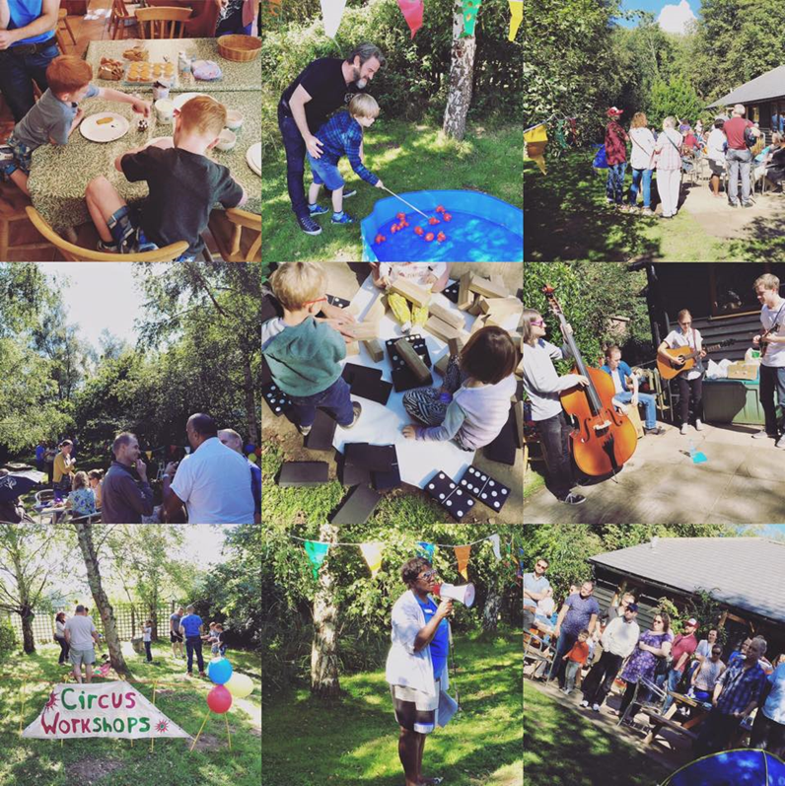
Adopter Social
First PACT Brighton and LGBT Adopter Social held Sept 2015
Open to adopters from PACT and Barnardo’s
Opportunity to socialise with other adopters/adopted families and fellow LGBT adoptive parents
Notes:
Rachel
Held our first PACT Brighton and LGBT Adopter Social on Sunday 20th September. Our first social was particularly special as it marked PACT Brighton’s one year anniversary.
As you can see from the photos we were very lucky with the weather!
Open to all our PACT Brighton families as well all PACT’s LGBT adopters and LGBT adopters from Barnardos.
Unlike our London and Reading family fun days it was open to those going through the assessment process in PACT, approved adopters waiting for a match and those who have children placed.
Important for those going through the assessment to meet and speak with adopters who have been matched, as well as those in a similar position. Particular important for LGBT adopters to meet others in similar situation. – find quote/ research.
need for LGBT adopters and foster carers to support each other, and to give our children the confidence of knowing other families like theirs.
As well as provide PACT families with children placed an opportunity to socialise with other adopted families/ kids with LGBT parents.
To facilitate this we provide a relaxed environment, food- BBQ, and stuff for the kids to do. With staff doted around to answer questions.
Encouraged adopters to mingle, exchange emails and had a couple of PACT experienced LGBT adopters to help host- and speak with those going through the process about their experience. They had stickers on saying ‘Ask me about my adoption journey’
As collected a list of email addresses, details of adopters interested in future social and support groups. Looking to start these in the new years.
…………………………………
*Show quotes*
The event was a great success and we will be holding a Brighton and LGBT Adopter Social annually.

Slide 9
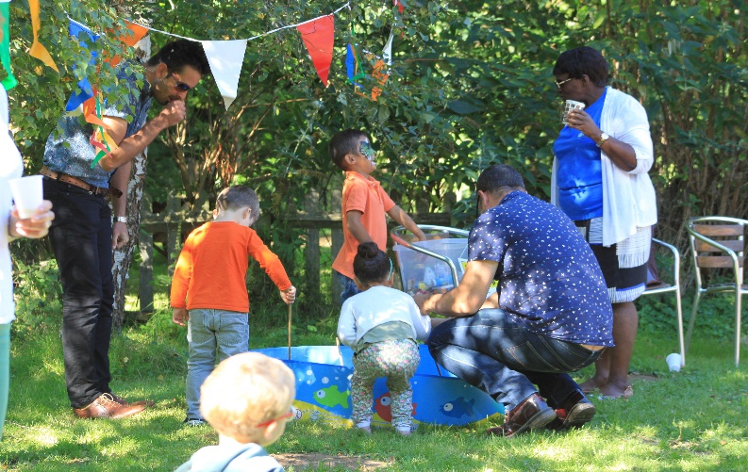
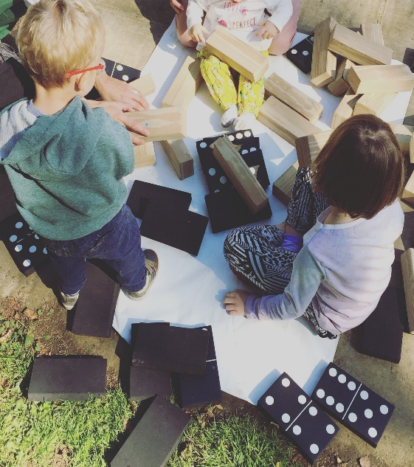
PACT Adopter Social
‘We have found everyone from PACT very friendly and welcoming and we look forward to returning next year with our children’
PACT Brighton Adopters
‘It was nice to meet other adopters in the area and see familiar faces too. It was great to share stories with other adopters’
PACT LGBT Adopters
‘It was a great day and very well organised. There was plenty for the children to see and do and participate in’ PACT LGBT Adopters

Slide 10
The Future
Brighton Twitter
Help and support from the LGBT community
Continue to collect ideas and feedback – learn and adapt
Notes:
Emma doing this one??

Slide 11
Conclusion and Q&A
Specialist project works - High percentage of LGBT adopters
They are confident that they will be accepted and service has a good understanding
Staff have a good understanding and acceptance of LGBT – so they can get on with assessment, rather than exploring their beliefs and sexuality
Notes:
Jean
Specialist project works - High % LGBT adopters
LGBT confident coming to a specialist service – they are confident that they will be accepted and service has a good understanding
Staff have a good understanding and acceptance of LGBT – means can get on with assessment, rather than exploring their beliefs

